Slide 1
進擊的巨頭—--
熱門網站的流量密碼 !
Attack on Titan—-
The Secret
of hot Website
NTUIM
Group 4

Slide 2
Overview
01
02
03
04
Method Description
Introduction
Analysis
Conclusion

Slide 3
Look at these Top Websites !
In these days, people promote and search for contents through the web.
Websites is still indispensable to convey knowledge and hold activities.
However, what factors influence the websites condition? Is it all about the content? What’s the features ? How to operate our websites nowadays?

Slide 4
01
Introduction

Slide 5
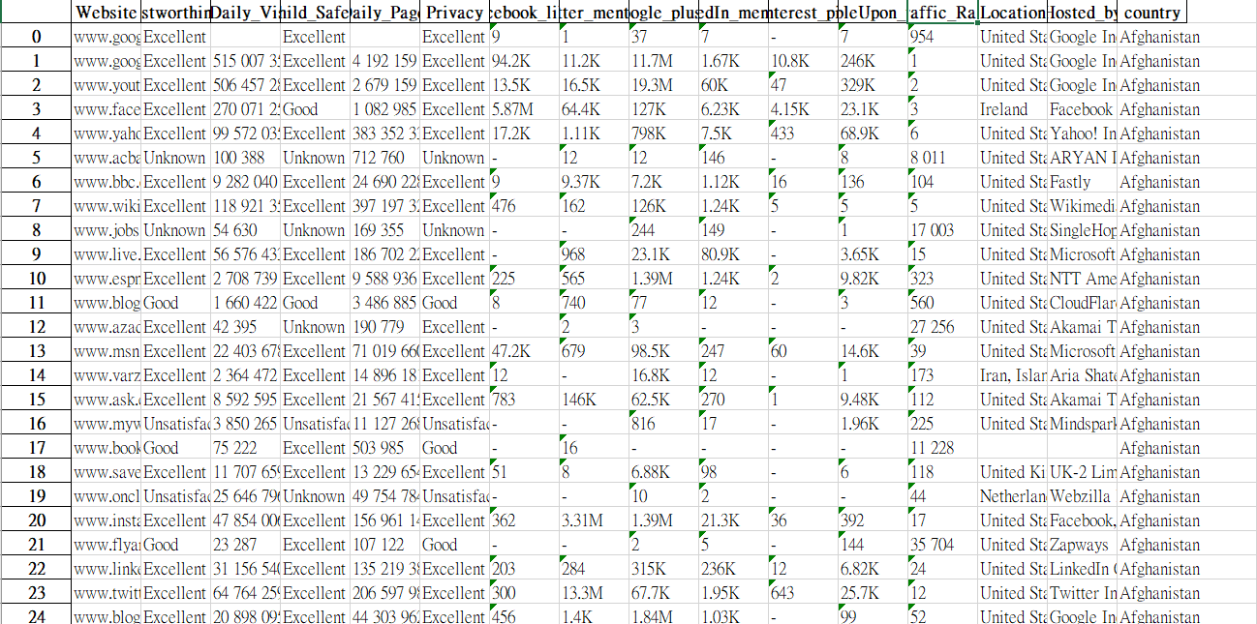
Data Source
https://www.kaggle.com/datasets/bpali26/popular-websites-across-the-globe

Slide 6
02
Method Description

Slide 7
Method to Utilize
01
02
03
Chart & Diagram
Simple-Regression
Multi-Regression

Slide 8
03
Analysis

Slide 9
Chart & Diagram
Distance between Earth and Moon

Slide 10
Pie Chart
25%
50%
75%

Slide 11
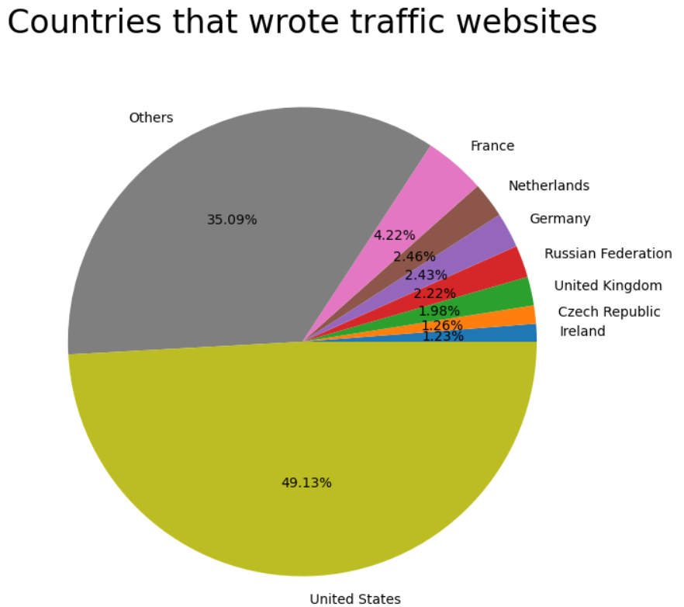
Which countries have more traffic sites? (All categories below 1% are calculated into Others.)
We can find out that the top websites written by United States account for nearly half of them.

Slide 12
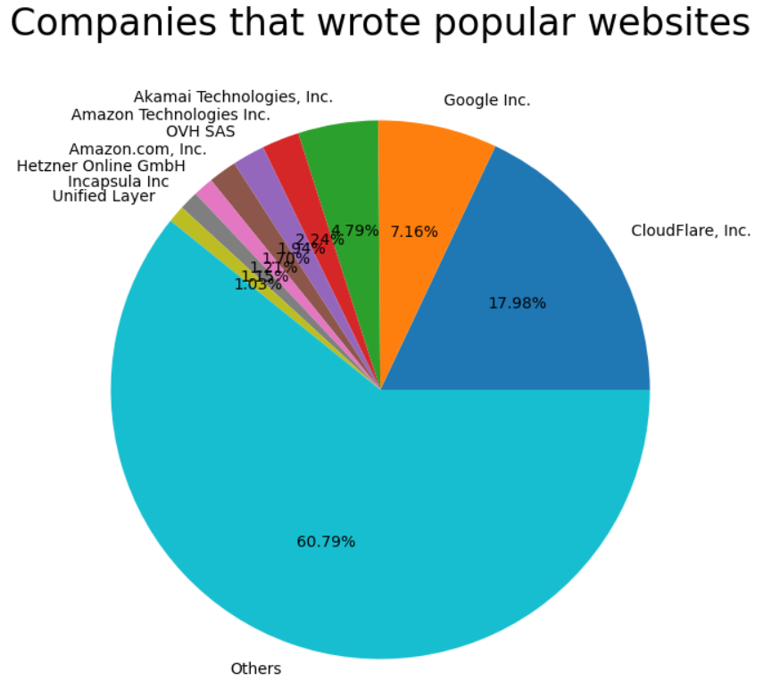
Which companies have made higher percentage of traffic websites?(All categories below 1% are calculated into Others.)
The first place, CloudFlare Inc, accounted for nearly 18%, which shows that the capital is dominant.

Slide 13
So what companies are owned by the countries that produce more than 1% of the traffic website?

Slide 14
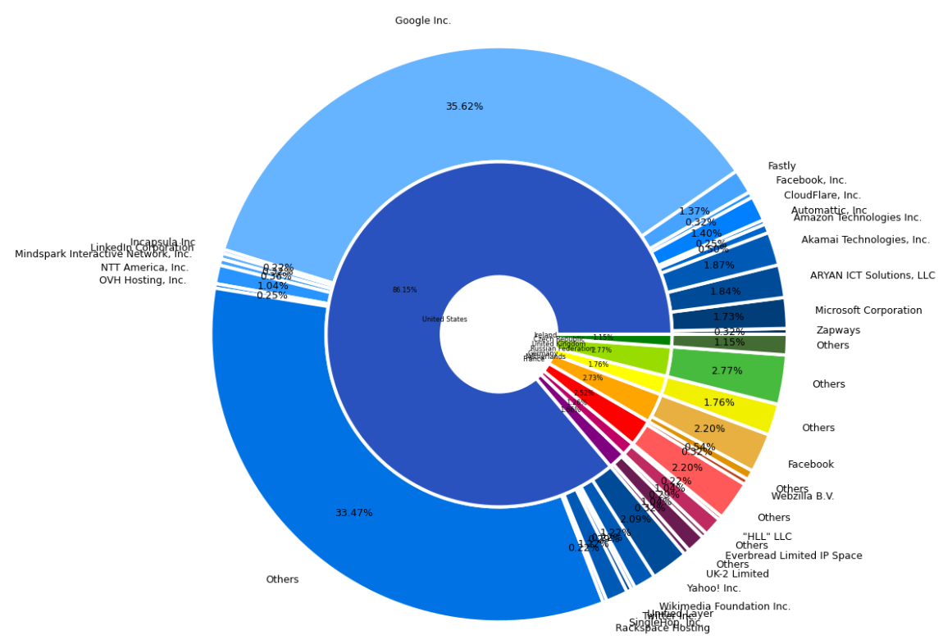
This diagram helps us to clarify the relationship between the company and the country of registration.

Slide 15
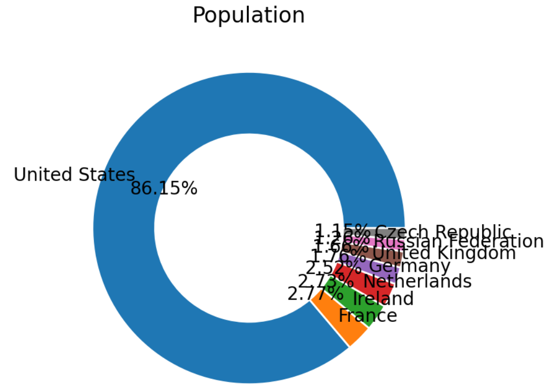
So what companies are owned by the countries that produce more than 1% of the traffic website?(extension)
We can see that the United States (especially google, and other small websites) controls the traffic of the world's websites.

Slide 16
Simple Regression

Slide 17
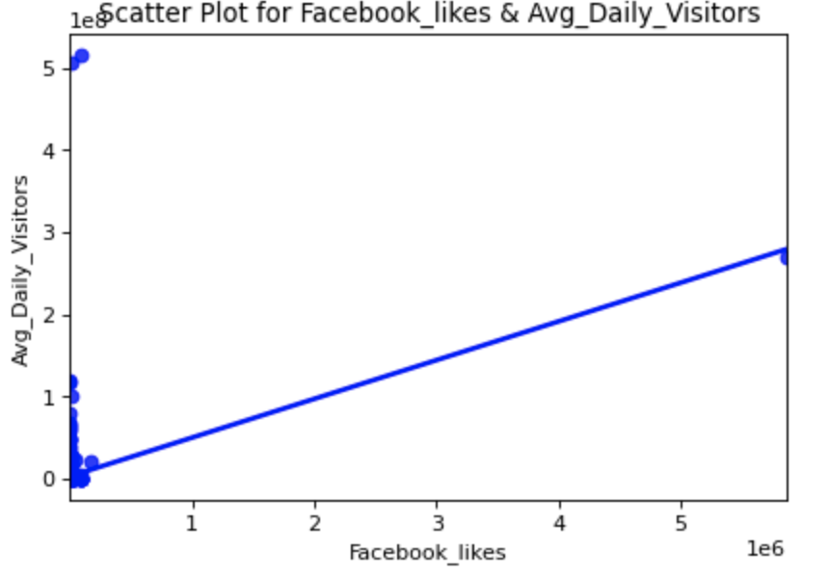
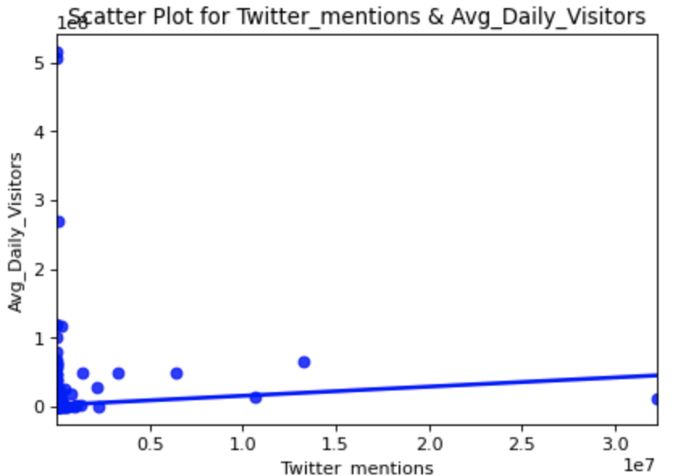
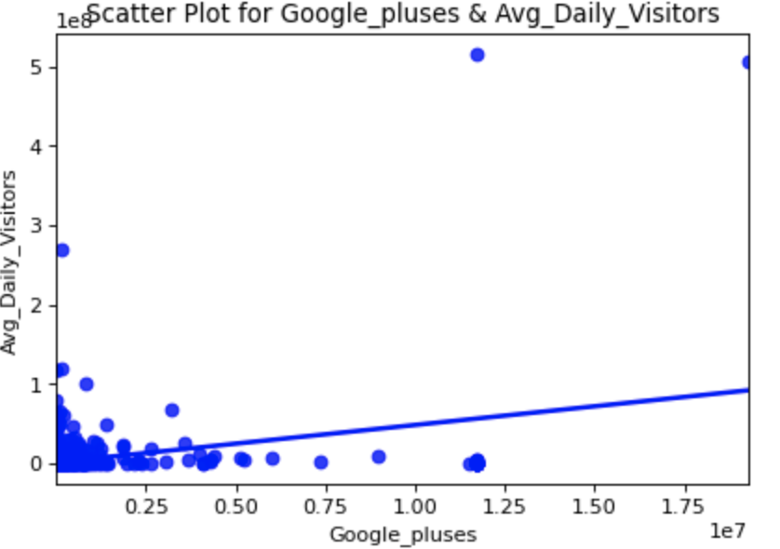
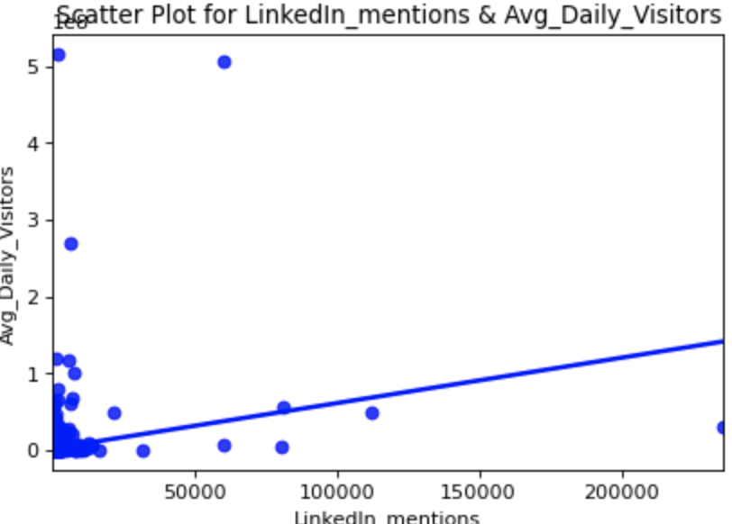
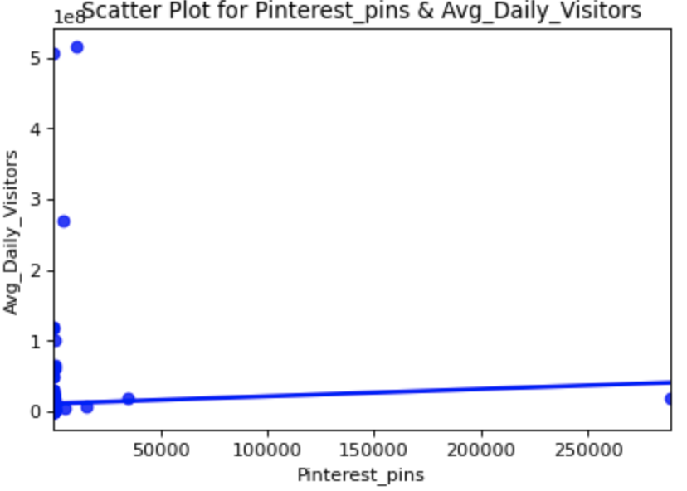
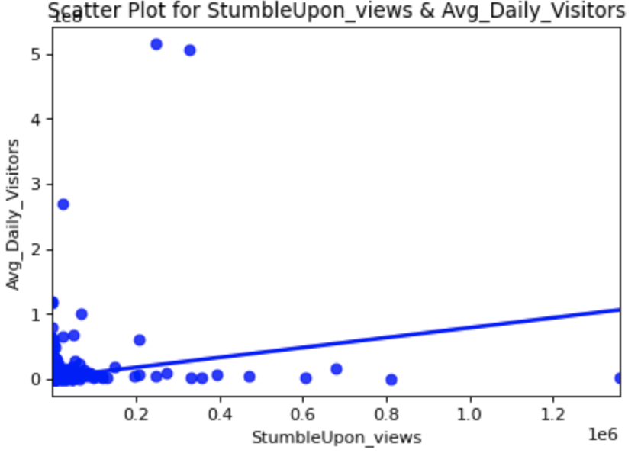
1. Plot the scatter diagram(AvgVisitors)

Slide 18
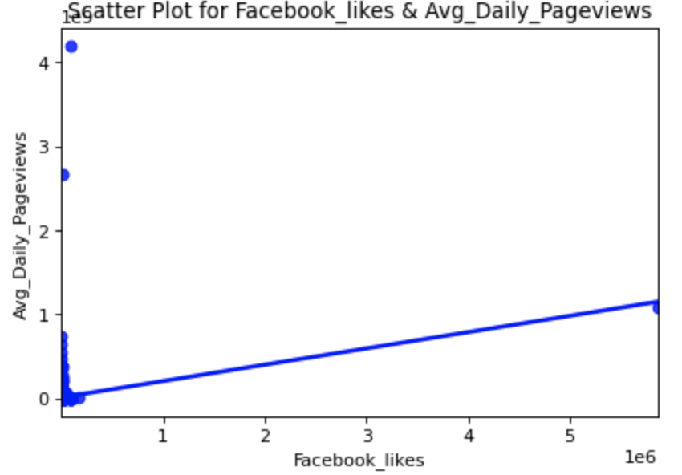
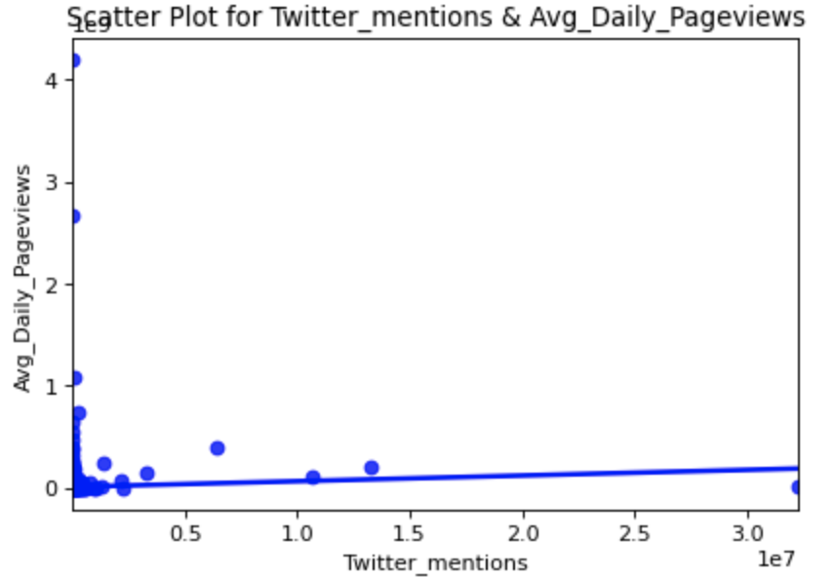
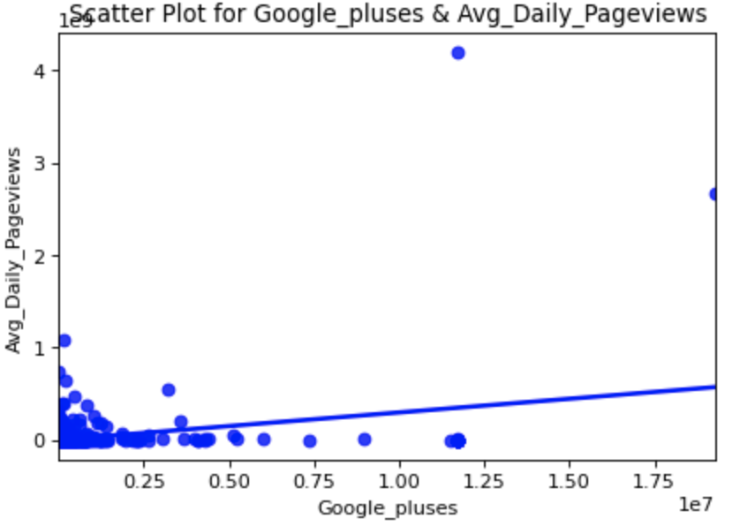
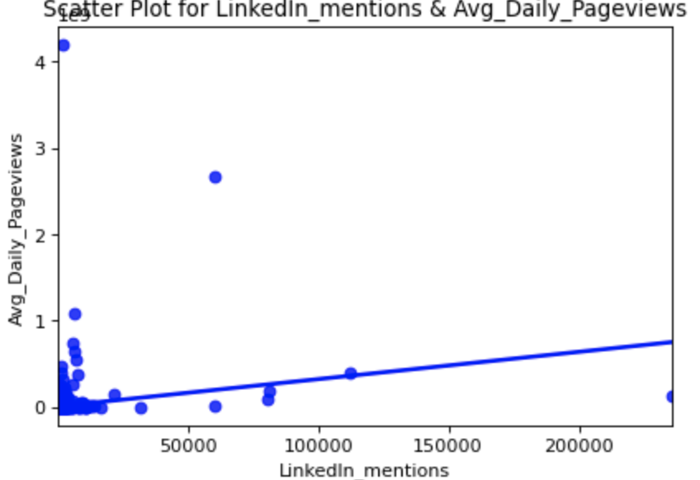
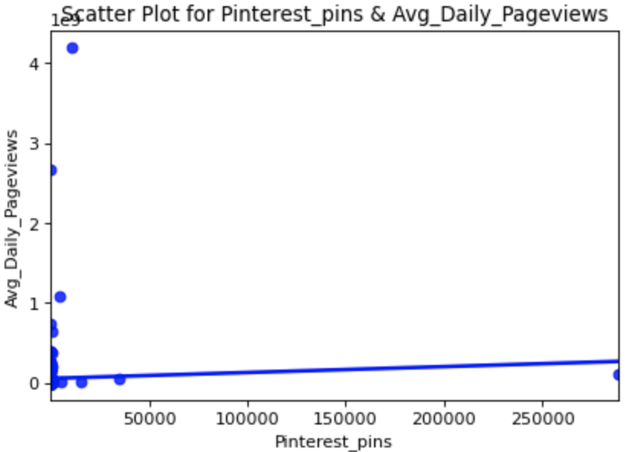
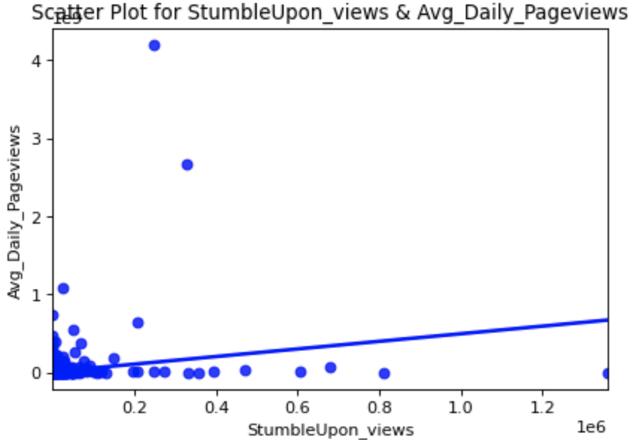
1. Plot the scatter diagram(AvgPageview)

Slide 19
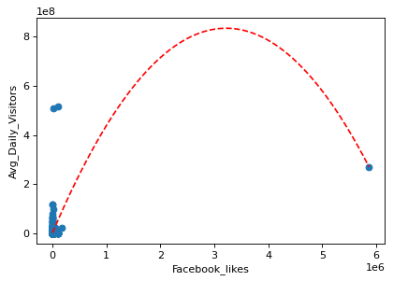
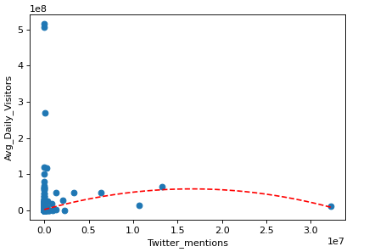
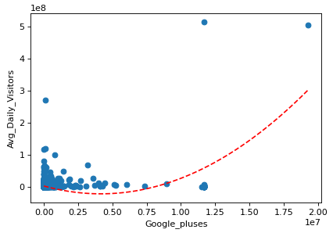
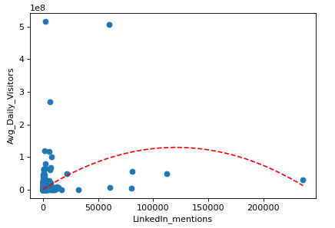
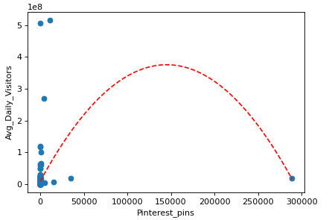
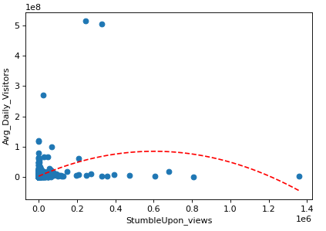
1. Plot the scatter diagram(AvgVisitors-second)

Slide 20
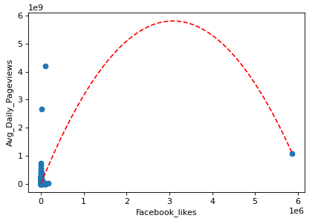
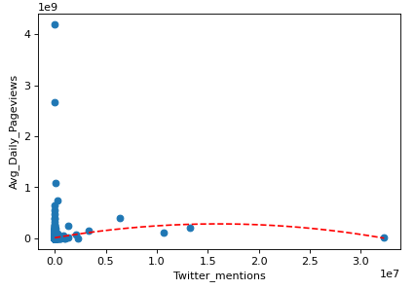
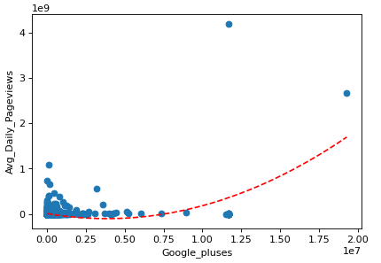
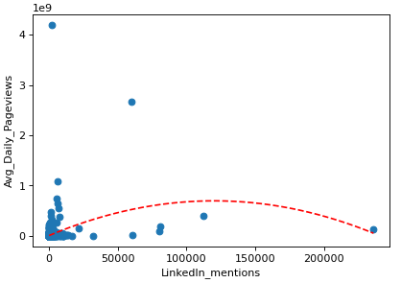
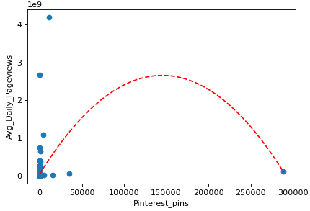
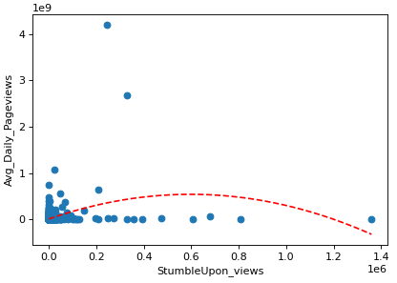
Plot the scatter diagram(AvgPageviews-second)

Slide 21
2. Propose a statistical model
Naturally, we assume that the y-value should increase when x increase, or at least not smaller than the one with little x.
From the scatter plots above, the regression line is indeed escalating in the first order condition, it corresponds to our original hypothesis.
However, in the second order condition, we observe that most of the curves are down curves, and some of which even have lower y when x becomes large.
Combine with the fact that the scatter plot distribution aren’t quadratic shape, we choose not to use the second order model.

Slide 22
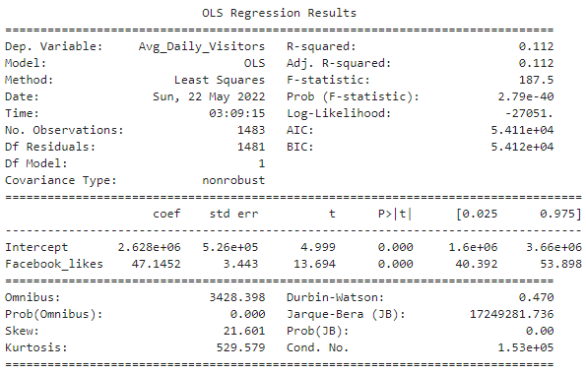
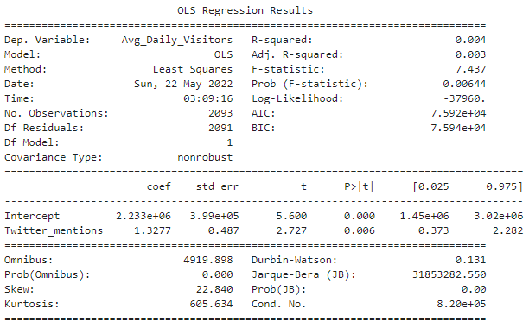
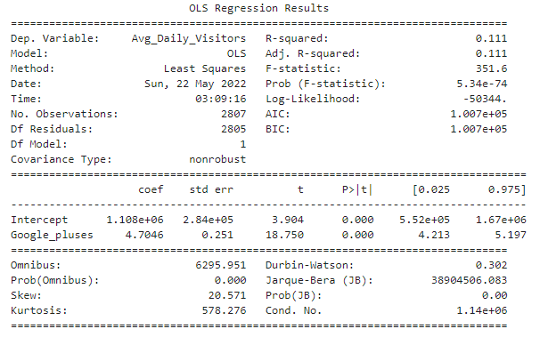
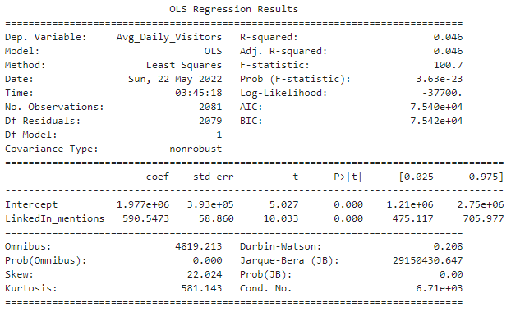
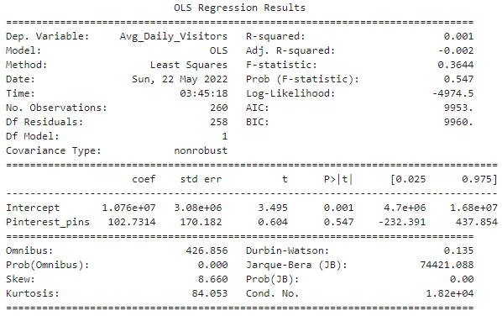
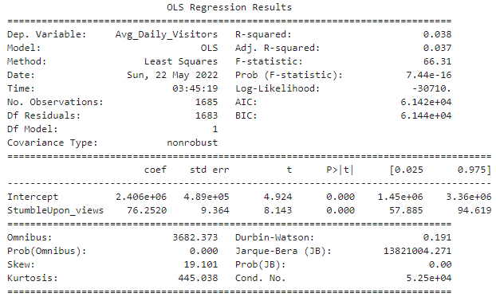
3. Fit the model
Most of the model pass the F-test & t-test, only pinterest failed.

Slide 23
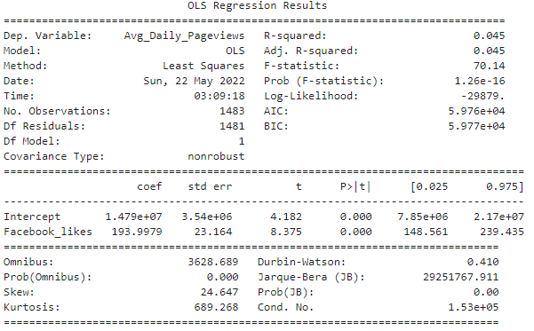
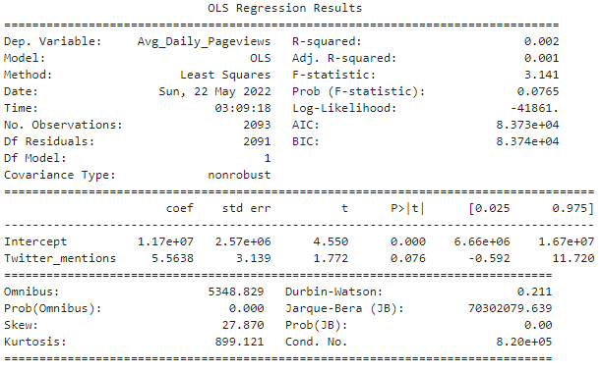
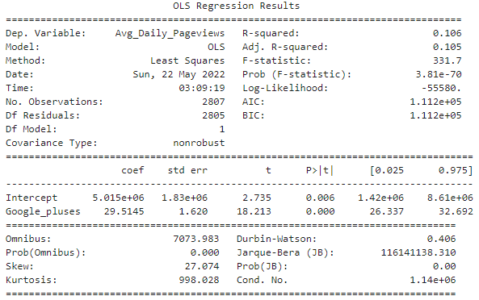
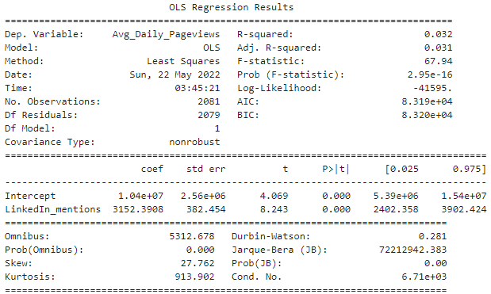
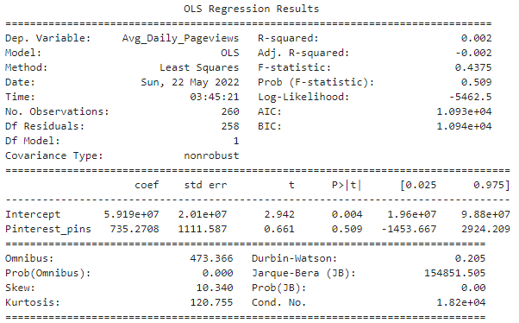
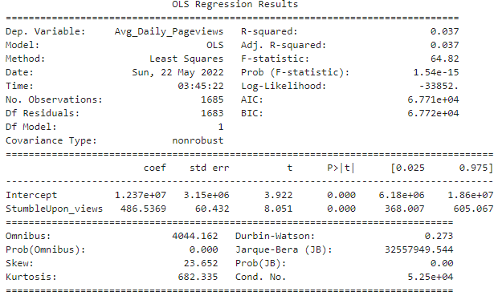
3. Fit the model
Most of the model pass the F-test & t-test, only twitter and pinterest failed .

Slide 24
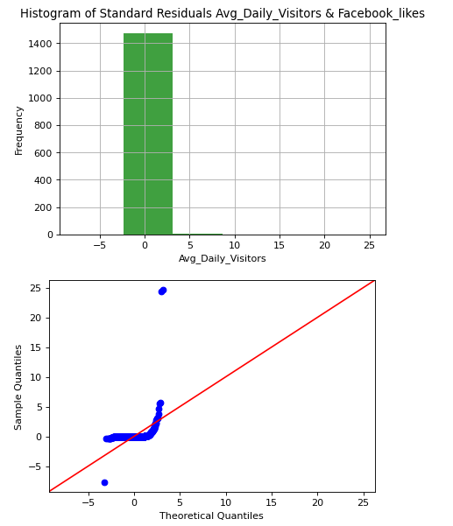
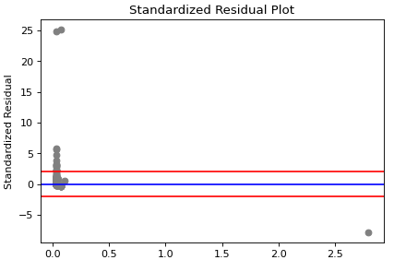
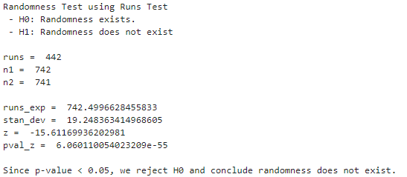
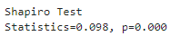
4. Residual analysis
Obviously,the required conditions are not satisfied. And this is the same for all 12 combinations
(6 independent variables & 2 dependent variable)
Ex: Facebook likes & Average daily visitors

Slide 25
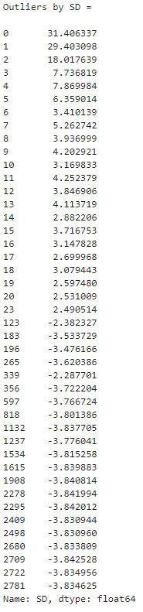
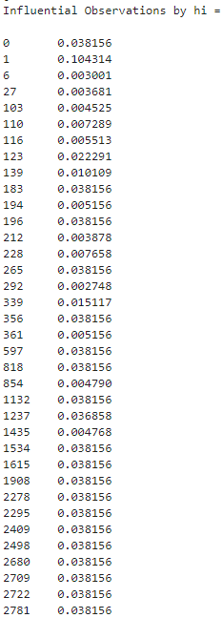
Among the 12 models, most of them have many outliers & influential observations.
Ex: Google pluses & Average daily visitors

Slide 26
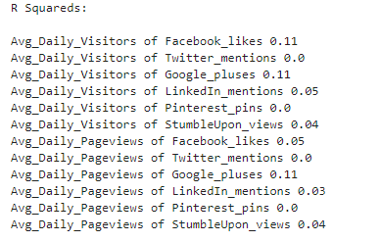

5. Assess the fitted model
We observe that the R^2 are low in general, we’re interested in why this would happen.

Slide 27
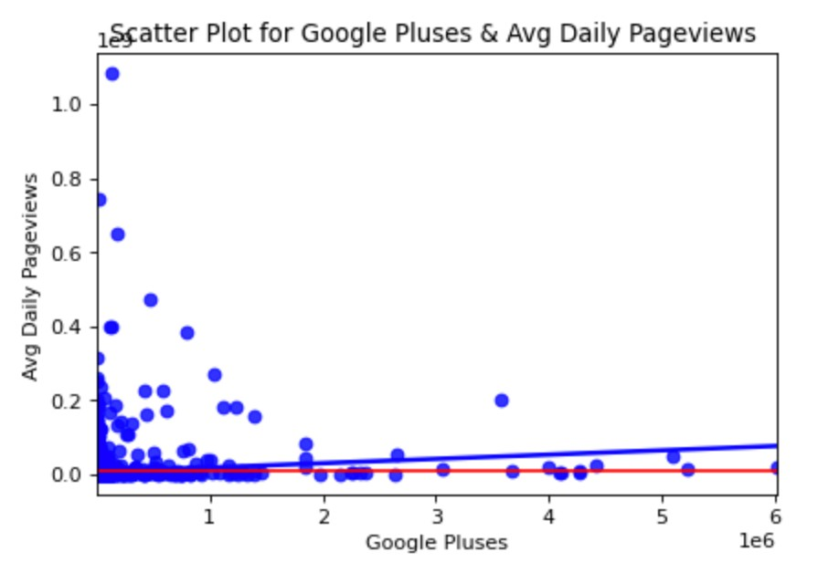
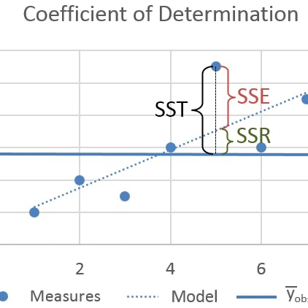

As we all know, R^2 = SSR/SST, also equal to SSR / SSR+SSE.
Since the SSR(regression line to the mean of y with same x) of some the points are very small in contrast to SST, they may cause a huge difference in R^2, causing the value to be considerably low.
This is an example

Slide 28

The original data may have some problem to find a suitable model,
So we propose two possible solution to fix the data.
Delete some
outliers
Take y as ln( y )
Take y as ln( y )
: this method can cut down the difference between the points with significantly high y and the other points.
Delete some outliers
: this method can simply remove these extreme points.

Slide 29






1. Plot the scatter diagram(log)

Slide 30






1. Plot the scatter diagram(log)

Slide 31

# log transformation of y,
# successfully shorten the distance from extreme points.
However, from the scatter plot & chart we can show that take ln(y) is not a good solution, although the points separate evenly above and beneath the beginning of the regression line, it is still not a good data to do regression analysis. Since we still can’t ignore the fact that the x’s are usually small, only gather at the area x = 0, so we can’t observe obvious linear relationship in it.
We speculate that it may due to the different strategies between companies.
Some may only focus on one or two of the x variables, and if we choose the variables the company doesn’t favor of, we might lead to a wrong conclusion.

Slide 32






1. Plot the scatter diagram(delete outliers)

Slide 33






1. Plot the scatter diagram(delete outliers)

Slide 34






2&3. Fit the model
Most of the model pass the F-test & t-test, only Facebook failed .

Slide 35






2&3. Fit the model
Most of the model pass the F-test & t-test, only Facebook failed .

Slide 36



4. Residual analysis
The data has become closer to normality. However, the required conditions of the 12 models are still not satisfied.
The situation got better, but it’s not enough.
Some of them pass the runs test and didn’t reject H0.
They are (Avg_Visitor, Avg_Pageviews) & (Twitter_mentions,LinkedIn_mentions, Pinterest_Pins)
Ex: Facebook likes & Average daily visitors

Slide 37


Among the 12 models, most of them still have many outliers & influential observations after deleting outliers.
Ex: LinkedIn_mentions & Average daily pageviews

Slide 38


5. Assess the fitted model
The table of R^2 result seems to have declare our success, but we can not make an accurate conclusion like “Facebook_likes isn’t important”, or “Companies should invest more cash to Pinterest”...,etc.
There are two reasons why we shouldn’t just apply this result :
First, as we have stated before,
the data may lead to inappropriate conclusion if too many companies put no emphasis on some of the x-factors and we still use to analyze.
Second, some may question why we delete outliers for 10 times, in fact, we tried to do it a few times, we think 1 or 2 is not enough, and 10 is a suitable number to apply on this large, disperse data.

Slide 39


5. Assess the fitted model
Take a look at Facebook, it is no longer a nice dataset, the origin upward trend is gone- - -
we might have deleted too much outliers. Actually, we can’t precisely determine how many times should we delete outliers, or we just shouldn’t do that. Maybe 5,10 times ?100 times? There is no correct answer, so in this case, we may have to look for the assistance of Multi-Regression.

Slide 40

Conclusion
With different ways implemented, the result of the models still don’t explain the visitors & pageviews well.
Besides, with the observations we got above,it seems that the popularity can’t just be analyzed with one single variable.
Thus, we should try Multi-Regression.
Can we analyze the question with single variable ?

Slide 41
Multi-Regression

Slide 42


Slide 43








1. Plot the scatter diagram(AvgVister-first)

Slide 44








1. Plot the scatter diagram(AvgVister-second)

Slide 45

1. Plot the scatter diagram(PageView-first)

Slide 46








1. Plot the scatter diagram(PageView-second)

Slide 47








1. Plot the scatter diagram(AvgVister-log)

Slide 48








1. Plot the scatter diagram(PageView-log)

Slide 49
2. Propose a statistical model
From some of diagram, the distributions look like log
Now we have three choices:
1. First-order
2. Second-order
3. Log transformation on y

Slide 50

2. Propose a statistical model——log transformation
The R-square value got very low in this way, and the scatter plot is also not good. We won’t use this
Now we have three choices:
1. Log transformation on y
2. Second-order
3. First-order

Slide 51
2. Propose a statistical model —— second-order
We observe that the diagrams of second-order diagram have lots of unfit curves which make the result weird.
Now we have three choices:
1. Log transformation on y
2. Second-order
3. First-order

Slide 52


2. Propose a statistical model —— first-order
Average Daily Visitors
Average Daily Pageviews
By all the observation above, we choose first-order to fit with highest R-square
3.Fit the model

Slide 53


4. Regression Diagnostics—Multicollinearity(AvgVister)
conflict with slope diagram
Multicollinearity exist ! !
Notes:
接下來我們要做的是Regression Diagnostics判斷我們的模型是否存在多元共線性或是自相關的問題
首先我們先看AvgVister的結果，也就是網站平均每日造訪人次。
從結果可以看出Twiter mention和StumbleUpon views的係數算出來是負的，這和我們的散部圖結論不同。(Twiter mention可能比較還好因為他的斜率幾乎等於零)所以我們可以斷定我們的model存在多元共線性的問題

Slide 54


4. Regression Diagnostics—Multicollinearity(AvgVister)
Notes:
我們利用Stepwise Regression和Best-Subsets Regression來做variable-selection
做出來的結果都會只留下FB、Google、Twiter、Linkedin這四個變數
刪除其他變數後我們有一個驚人的發現，R-square並沒有因此而下降!!!
這代表其他的這些變數其實對於模型一點幫助都沒有，然而我們可以發現Twiter並沒有被刪除於模型之外且他的係數仍為負值
但由於他的斜率幾乎等於零，我們就暫時把她繼續留下來當作已經解決多元共線性的問題先做後續分析。

Slide 55




4. Regression Diagnostics—Autocorrelation(AvgVister)
Notes:
自相關的部分我們做完Durbin Watson test後發現我們的資料有自相關的問題
我們嘗試把Twiter刪掉或是用各種其他的變數組合但不只解釋力降低且仍然無法解決自相關的問題
這使我們開始思考是否就和散部圖想傳達給我們的資訊一樣，我們擁有的這些資料其實和我們的網站的平均造訪人數並不存在線性關係。

Slide 56



4. Regression Diagnostics—Multicollinearity(PageView)
conflict with slope diagram
Multicollinearity exist ! !
Notes:
而網站平均每日瀏覽次數的結果和平均每日造訪人數的結果大同小異，原本8個變數的模型存在多元共線性的問題
Twiter和StumbleUpon的係數都與散布圖結果不相符。
但不論我們如何調整模型，除了解釋力會更低之外，也無法解決data存在自相關。

Slide 57

4. Regression Diagnostics—Autocorrelation(PageView)
Notes:
所以我們還是使用Stepwise Regression和Best-Subsets Regression這兩個方法做variable-selection
結果留下FB、Google、Twiter、Linkedin這四個變數。

Slide 58


4. Regression Diagnostics—Autocorrelation(PageView)
Notes:
Durbin Watson test一樣顯示我們的資料有自相關的問題

Slide 59




5. Residual analysis(AvgVister)
We have no choice but keep going : (
Notes:
接著我們繼續做殘差分析，結果更使我們失望
常態假設和同質變異的虛無假設都無法拒絕，在此幾乎可以肯定的是我們的資料來源可能有問題
也許是因為我們是取各國前50名的網站當作資料(所以資料來源本身就不是常態)，資料本身太少也是個大問題(刪除一些空欄位後只剩下170多筆資料)
但我們也只能先繼續做後續分析。

Slide 60



5. Residual analysis(AvgVister)
There are so many outliers and influential Observations ! !
This might affect the explanatory power of our result ! !
Notes:
我們發現資料當中存在很多outliers and influential Observations ，這也可能是導致我們的殘差分析無法拒絕虛無假設的原因。

Slide 61



5. Residual analysis(PageView)
We have no choice but keep going : (
Notes:
網站平均每日瀏覽次數的結果也差不多，常態假設和同質變異的虛無假設都無法拒絕

Slide 62



5. Residual analysis(PageView)
There are so many outliers and influential Observations ! !
This might affect the explanatory power of our result ! !
Notes:
outliers and influential Observations也一樣很多

Slide 63



6. Assess the fitted model(AvgVister)
F-test
Std Err Estimate
R-Square
Notes:
接下來我們進行Assess model
從F-test結果可看出我們的模型是有拒絕虛無假設的，所以至少有一個變數對於平均每日造訪人數是有影響的。
Std Err Estimate的結果看出雖然我們的標準差是3000多萬，但和y值6000萬相比，已經有減少很大一部份的標準差了。
從R-square可看出平均每日造訪人次有65%左右的變異可被我們的模型解釋，所以宗和以上結論，可以說我們的模型還是有效的。

Slide 64

6. Assess the fitted model(AvgVister)
ANOVA t test
Notes:
我們可以從ANOVA t test看出FB like、Google 社群提及是重要變數，而Twiter和Linkdin由於Pvalue>0.05所以比較不重要

Slide 65


6. Assess the fitted model(PageView)
F-test
Std Err Estimate
R-Square
Notes:
平均每日瀏覽次數，F-test、Std Err Estimate都顯示模型有效R-square也可看出平均每日瀏覽次數有54.9%左右的變異可被我們的模型解釋

Slide 66

6. Assess the fitted model(PageView)
ANOVA t test
Notes:
同樣的從ANOVA t test看出FB like、Google 社群提及對網站平均每日瀏覽次數是重要變數，而Twiter和Linkdin由於Pvalue>0.05所以比較不重要

Slide 67



7. Interpretation(AvgVister)
Notes:
該網站在fb社群被多得到一個讚，我們預期他的平均每日造訪人數會多46人
該網站在google社群被多一次的提及，我們預期他的平均每日造訪人數會多21人

Slide 68

7. Interpretation(PageView)
Notes:
該網站在fb社群被多得到一個讚，我們預期他的平均每日瀏覽次數會多188人
該網站在google社群被多一次的提及，我們預期他的平均每日瀏覽次數會多10人

Slide 69
04
Conclusion

Slide 70
Diversity
A website’s popularity can’t be explained by solely one variable, which seems reasonable in reality.
Remind
Influential factors
There are some inconsistency and requirement problems in the data and model
Need to be used with caution in different condition
Google plus and Facebook likes
Websites distribution
There are still tons of small websites with low traffic. All of them together still have lots of proportion.
Notes:
根據上面的研究結果，我們根據每個階段得出結論。
由圖表的分布可以發現，大牌公司Google與Cloudflare就占了四分之一，不過小於總量一趴的網站聚集起來也佔了60趴的比率，相當可觀
並且，網站的流量相關性大多無法由單一社群因素相關，可能有多種不同因素相互影響。
在模型可使用的情況下，結果顯示若一個網站在fb社群和google社群有越多的提及代表這個網站越有可能有很高的瀏覽次數與造訪人次，其他變數則和瀏覽次數數和和造訪人次則沒有顯著關係
最後還是要提醒一下，此模型存在一些inconsistensy，多半由於資料數並無足夠常態分配及多樣性不足，所以要視情況調整

Slide 71
Recommendation to the website operation
1. Try to promote your websites with different social medias. If with limited budget, choose Google pluses for more visitors, or choose Pinterest for more pageviews.
2. Google and Facebook have most relation with website traffic, maybe these have newest information or have more influence on websites.
3. Data need to be required with more websites median scale and diversity, so the result would be more accurate.
Notes:
從結論來看，我們可以在適當情況提供以下的建議；
1.在有限的社群宣傳資金下，在多項平台投放比起單一平台投注大量廣告效果較佳
2.Facebook與Google社群的提及與流量的相關性較大，可能平台包含較新、流量資訊或者對平台有較大穎或者對平台有較大影響力
3.網站流量分析需要更多常態性與多元性，包含中小型網站與除了搜尋引擎及社群媒體的資料會對結果較有合理解釋性

Slide 72

Thank you for listening !

